Slide 1
Knowledge Distillation On LLM
Xinru

Slide 2
Problem
As language models continue to improve in performance, their size has also increased significantly. However, deploying these large models can be challenging. In this study, I explored knowledge distillation as a potential solution to this problem.

Slide 3
Background
large language models have become the cornerstone of many NLP tasks, demonstrating state-of-the-art performance.
Fine-tune
Prompt

Slide 4
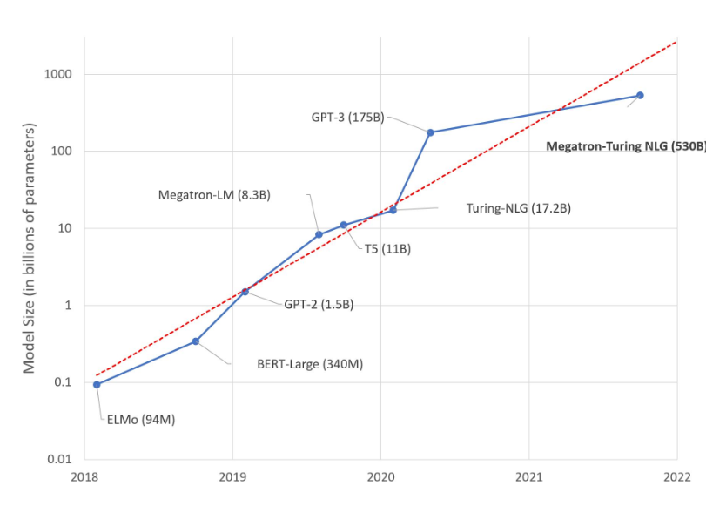
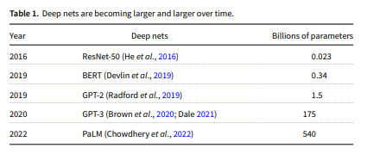
Background

Slide 5
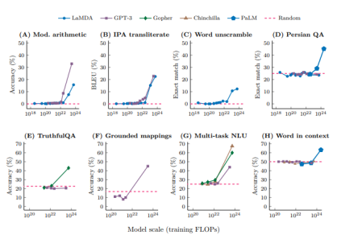
Background
Emergent abilities of large language models (Wei et al., 2022)

Slide 6
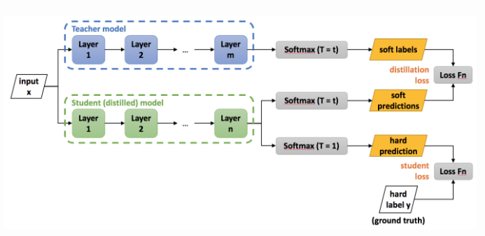
Methodology
Knowledge Distillation
Teacher -> Student Model
Distillation Loss
Language Modeling Loss
However, it doesn’t work well on large language models

Slide 7
Teacher Model
linear_net(
(linear_1): Linear(in_features=784, out_features=1200, bias=True)
(relu): ReLU()
(dropout): Dropout(p=0.5, inplace=False)
(linear_2): Linear(in_features=1200, out_features=1200, bias=True)
(linear_3): Linear(in_features=1200, out_features=10, bias=True)
)

Slide 8
Student Model
small_linear_net(
(linear_1): Linear(in_features=784, out_features=50, bias=True)
(relu): ReLU()
(linear_2): Linear(in_features=50, out_features=10, bias=True)
)

Slide 9
Model Accuracy Comparison
Teacher Model (20 epochs)
Train accuracy: 99.66%
Validation accuracy: 98.18%
Test accuracy: 97.84%
Student Model (14 epochs)
Train accuracy: 97.16%
Validation accuracy: 96.64%
Test accuracy: 96.50%

Slide 10
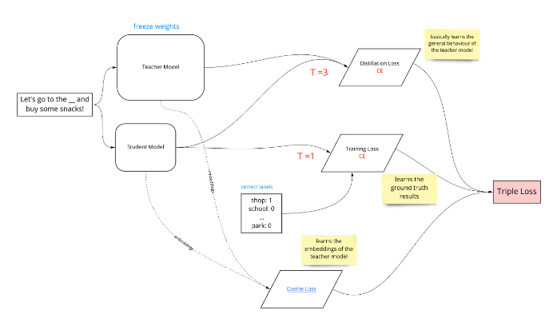
Methodology
However, it doesn’t work well on large language models
Cosine Distance Loss

Slide 11
Models And Training Data
GPT2
1.5 Billion parameter size
Decoder-only Transformer
OpenWebTextCorpus
41.7 GB
BPE Tokenizing

Slide 12
Result
Parameter Size
1.5 billion -> 82 million
Inference Speed
Small GPT2 is 60% faster than GPT2

Slide 13
Result
 | GPT2 | DistillGPT2
wikitext-103 | 29.16 | 47.61
PTB | 35.86 | 85.56
enwik8 | 18 | 50.90
lambada | 45.28 | 100.01
common_gen | 1.07 | 10.26

Slide 14
Conclusion
Using knowledge distillation technique could largely reduce the parameter size of a LLM while maintaining the performance of the model.

Slide 15
Discussion
Result Solely from label
VS
Result From the training process

Slide 16
Reference
Sanh, Victor, et al. "DistilBERT, a distilled version of BERT: smaller, faster, cheaper and lighter." arXiv preprint arXiv:1910.01108 (2019). Geoffrey E. Hinton, Oriol Vinyals, and Jeffrey Dean. Distilling the knowledge in a neural network. ArXiv, abs/1503.02531, 2015.
Radford, Alec, et al. "Language models are unsupervised multitask learners." OpenAI blog 1.8 (2019): 9.
Church, Kenneth Ward. "Emerging trends: Deep nets thrive on scale." Natural Language Engineering 28.5 (2022): 673-682.
Brown, Tom, et al. "Language models are few-shot learners." Advances in neural information processing systems 33 (2020): 1877-1901.
Wei, Jason, et al. "Emergent abilities of large language models." arXiv preprint arXiv:2206.07682 (2022).
Hinton, Geoffrey, Oriol Vinyals, and Jeff Dean. "Distilling the knowledge in a neural network." arXiv preprint arXiv:1503.02531 (2015).
Devlin, Jacob, et al. "Bert: Pre-training of deep bidirectional transformers for language understanding." arXiv preprint arXiv:1810.04805 (2018).
Bender, Emily M., et al. "On the Dangers of Stochastic Parrots: Can Language Models Be Too Big?." Proceedings of the 2021 ACM conference on fairness, accountability, and transparency. 2021.
Jobin, Anna, Marcello Ienca, and Effy Vayena. "The global landscape of AI ethics guidelines." Nature Machine Intelligence 1.9 (2019): 389-399.
Sennrich, Rico, Barry Haddow, and Alexandra Birch. "Neural machine translation of rare words with subword units." arXiv preprint arXiv:1508.07909 (2015).
Radford, Alec, et al. "Learning transferable visual models from natural language supervision." International conference on machine learning. PMLR, 2021.

